Slide 1
Git 101
Or: Git for Gits
David Muckle

Slide 2
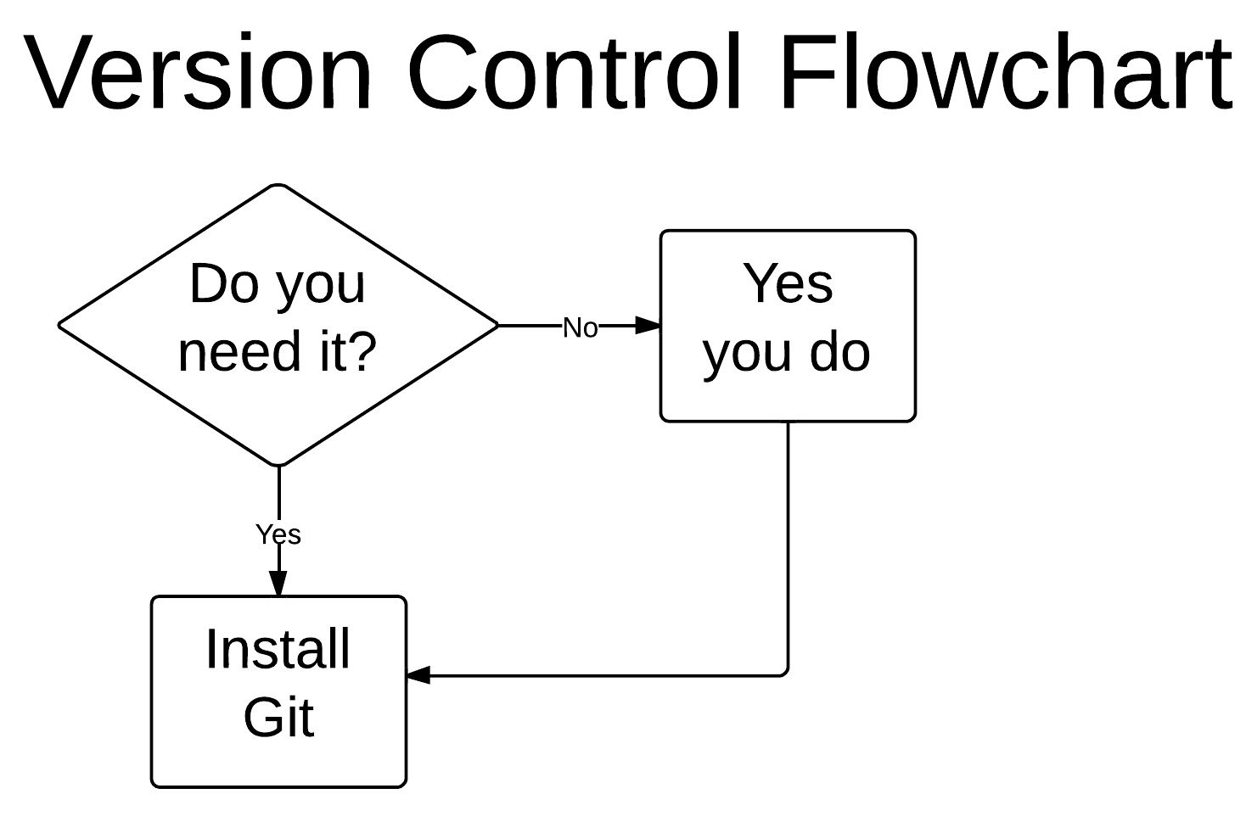

Slide 3
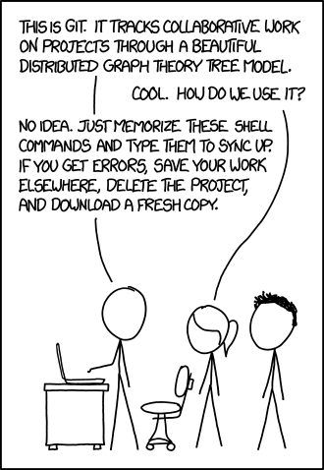
What is Git?
VCS (Version Control Software)
CVS, Mercurial, Git
Keep track of changes
Revert back to old changes
Keep multiple versions of a project
Merge versions
Synchronize projects between machines
Keep your project “in the cloud”

Slide 4
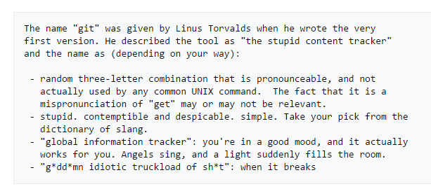


History of Git
Use in Linux development
Replacing BitKeeper
Use online
GitHub, BitBucket
Notes:
Quick slide, highlight how Git came to be and its origins.
4

Slide 5
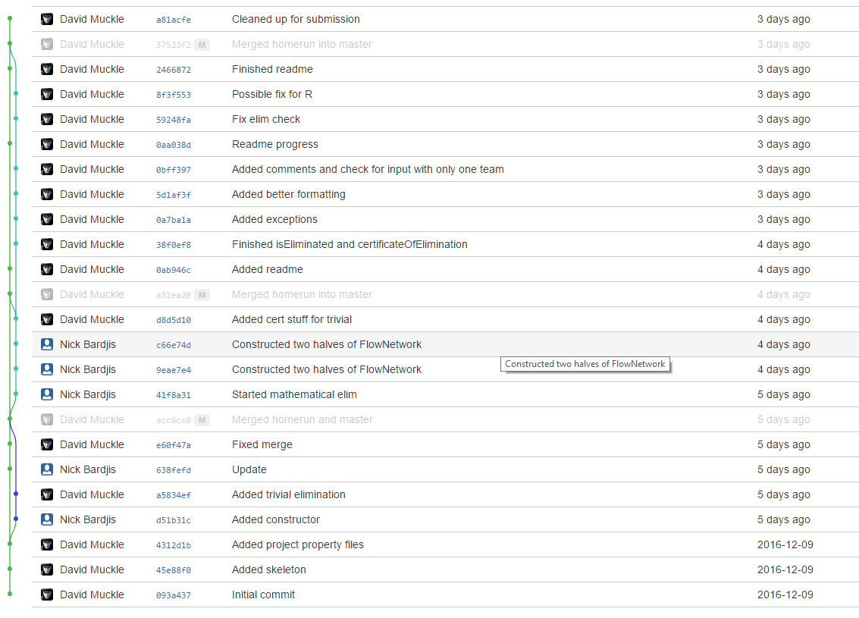
The Git Basics
git init
git clone http://example.com/repo
Use http or ssh
git add somefile.thing
git status
git commit -m ‘Comment’
git push
git pull
git branch branchname
git checkout branchname
git merge
Notes:
Break here to go through a live demonstration of each of these commands.
5

Slide 6
git init and git clone
git init for a new project
Run in a folder with all your project materials
Creates a .git folder within your project folder, DON’T TOUCH THIS
git clone for an existing project
Clone the project from some online source like BitBucket or Github.
git clone https://github.com/username/project
git clone ssh://git@github.com/username/project

Slide 7
Aside: SSH and Git
SSH can be used to facilitate cloning and other stuff with online projects
Uses a keypair for authentication
Public key and private key
ssh-keygen to make a new keypair
Put your public key on things you want to “unlock” with your private key
Keep your private key safe
Put your public key on Github or Bitbucket to clone and interface with projects without having to enter your username and password every time

Slide 8
git add
Tell Git to start “tracking” a file
Can have tracked and untracked files in a repository
Only tracked files will be saved by Git
git add .
Tell Git to add all files in your repository, including files in other folders
git add *
Add only the files in the folder you’re currently in
git add filename
Just add one specific file
git rm filename

Slide 9
git status
Tells you what’s tracked, untracked, what’s ready to commit, status of upstream remotes, branch…
Useful after doing any git command to double check everything’s good
A way to get your bearings in a repo

Slide 10
git commit
Git’s “save” button
Makes a save of all the files you currently have tracked, and changes to anything you’ve changed and are still tracking
Needs a comment to go with it
git commit –m ‘Commit comment’
Otherwise a text editor like vim or nano will open up
This is annoying. Just use –m.
Git creates a unique hash value of your commit to refer to later
CS160 people, what does that mean? ☺

Slide 11
git push
Upload your changes to an online “remote”
If you cloned from an existing “remote,” you don’t need to set up a remote
git push –u origin master
git remote add origin https://bitbucket.org/username/repo
If you started a project locally using git init
Git might ask you some config settings.
Defaulting to “matching” is fine

Slide 12
git pull
Download new changes from online
Useful to do before working on a project, to avoid conflicting changes
Awesome if you’re working with another person
Will default to the information that you used during git clone or git push

Slide 13
git branch and git checkout
git branch branchname
Creates a separate copy of your project from the current point in time
Git creates the ‘master’ branch by default
Need to create a new branch on the remote as well
git checkout branchname OR git checkout commithash
Switch to a branch OR revert back to an old commit
Make sure to commit your changes before switching branches, else you will lose said changes
git stash
Makes a temporary commit. Where does it go? Use git stash list
git stash apply to go back to a stash

Slide 14
git merge
Merge two (Or more!) branches together
Happens automatically if you do a pull while having local commits not in the remote
If you’re on the master branch and do git merge dev, it will pull in the changes from dev and apply them to master
Also good to use -m ‘Comment’ with as well, same as git commit
Useful for working on stuff that doesn’t work yet, then merging it into a branch where everything does work
Still keeps the branch you merged changes from
Can be done with more than one branch (Octopus merge)
Linux kernel once did a 66 way merge!
What happens if two files have a different line in both branches?

Slide 15
Other commands
git diff commithash commithash OR filename filename
Show the difference between two files, two commits, two branches…
Nice and colorized!
git blame filename
Show, line by line, who did what in a file
Find out who to blame for a bug thank for a feature
Also shows commits something happened in
git reflog
A “time machine” of all things you’ve done in Git

Slide 16
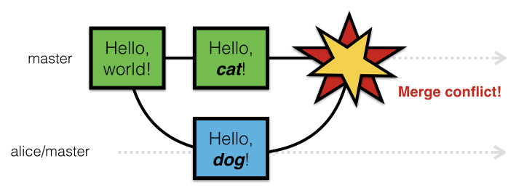
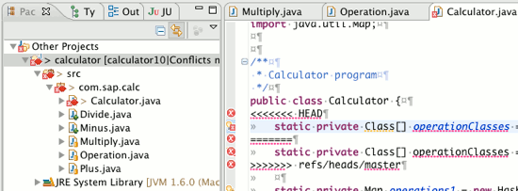
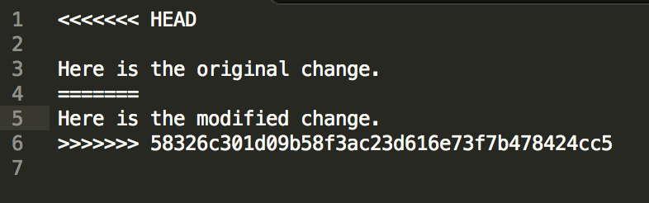
What to do if Git breaks
Notes:
A situation that many people might run into, hence a few slides on it.
16

Slide 17

Notes:
Self explanatory.
17

Slide 18
Resolving Merge Conflicts
Stay calm
Read the marked changes
Talk with your partner(s)
Figure out what to keep
Edit accordingly
Push changes
Notes:
Live demonstration of resolving a merge conflict here. Also highlight that if worse comes to worse, making a backup of code and nuking the local repo is fine too.
18

Slide 19
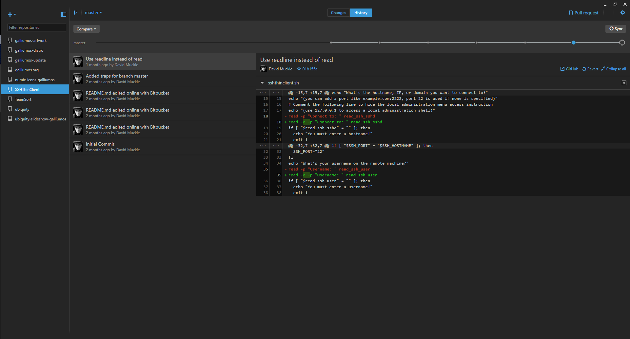
Graphical Clients
Integration with IDEs
Eclipse, Netbeans, IntelliJ
Standalone Clients
GitHub Client, Atlassian SourceTree, Git GUI
Notes:
Stress that learning how to use Git on a command line is a must before using graphical clients, as if something screws up on the client one can fall back to the command line.
19

Slide 20
Suggested Setup for Pair Programming
Use BitBucket
Create repository with private access
Add members to repository
OR
Create team with partner
Create repository under team
Notes:
Basically what this whole presentation is for. Make note that this is only one of many ways to do this.
20

Slide 21
Using with your Clark CS Account
Create a repository on system
Commit changes
On local computer, git clone ssh://username@csgateway.clarku.edu/home/username/pathtorepo
Won’t work with pair programming
Notes:
Because people really don’t use this resource enough!
21

Slide 22
Can I use Git for other things?
Absolutely!
Essays
Cover letters
Image editing
Recipes
Program settings (dotfiles)
This PowerPoint
Aside: Git works best with text files, but can still be used with non-text files
Notes:
Because Git is really cool and can be used for a whole bunch of things.
22

Slide 23
Other Git Resources
Oh Shit, git! http://ohshitgit.com
Git will break. Here’s how you can fix it
Gitless http://gitless.com/
A nice “porcelain” to use with Git
Github
The hub… For Git… It’s in the name folks
Has some helpful docs and is the place for open source projects
Atlassian (BitBucket)
Has some more docs, slightly better formatting than Github
git command --help
Pulls up a webpage or “man” page on any git command, complete with all the options you can use.
Notes:
23

Slide 24
Go forth and Commit!

